Slide 1
Models for macroparasites
Cristina Lanzas
CBS 810 Infectious disease modeling
2015

Slide 2
Learning objectives
Explain key characteristics of the dynamics of macroparasites (complex life-cycles, heterogeneity on the parasite burden, density-dependent constraints)
Define the basic reproduction number for macroparasites
Explain how host-parasite feedbacks are incorporated in macroparasite models.

Slide 3
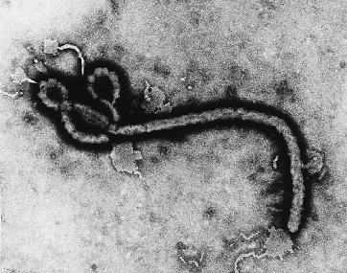
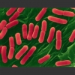
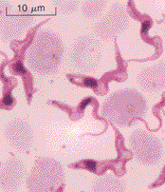
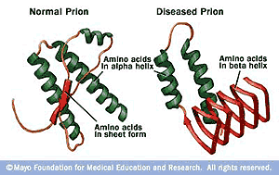
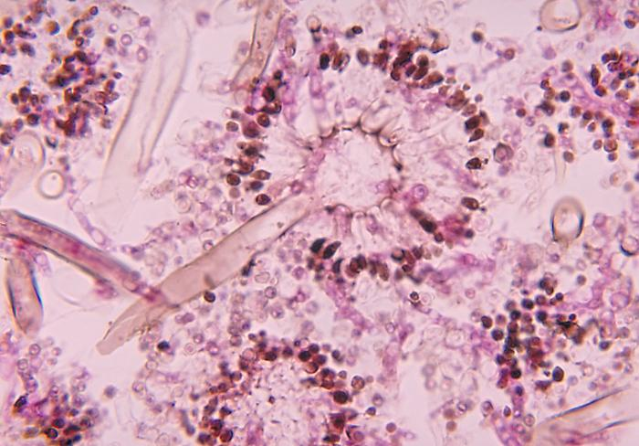
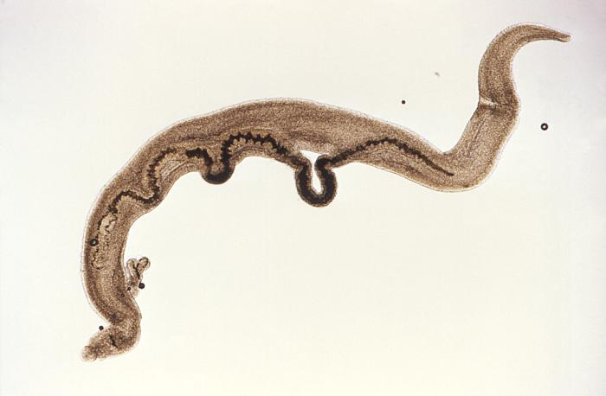
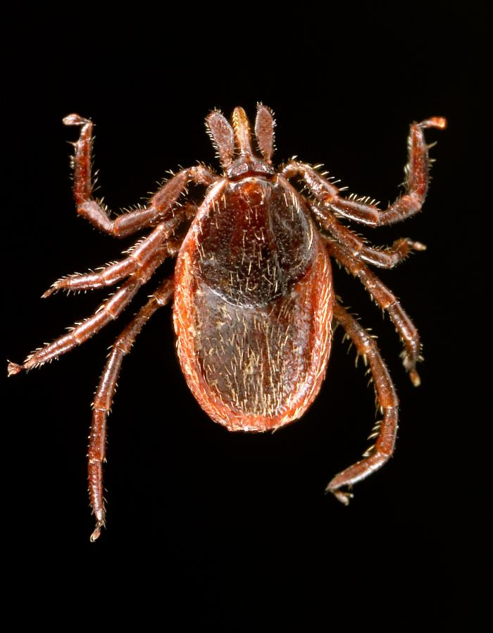
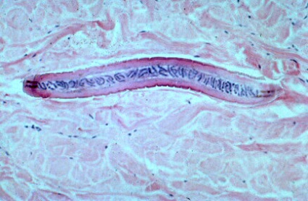
Classification of infectious agents
MICROPARASITES
Ebola virus
Virus
Protozoa
Bacteria
Trypanosoma
Prions
Fungi
Escherichia coli O157
Aspergillus
MACROPARASITES
Trematodes
Nematodes
Ectoparasites
Schistosoma mansoni
western blacklegged tick
Mansonella streptocerca

Slide 4
Macroparasites
Specialized infective stages and complex life cycles
Do not multiply within the host, reproduce and release eggs or larvae into the environment
Host morbidity depends on burden
Unit of interest: Host parasite burden

Slide 5
Life cycles
Direct life cycle: The parasite is transmitted to another host by means of a stage that lives free in the environment.
Indirect life cycle: more than one type of host is involved in the life cycle.
Definitive host: sexual reproduction takes place
Intermediate host: onward development or asexual reproduction

Slide 6
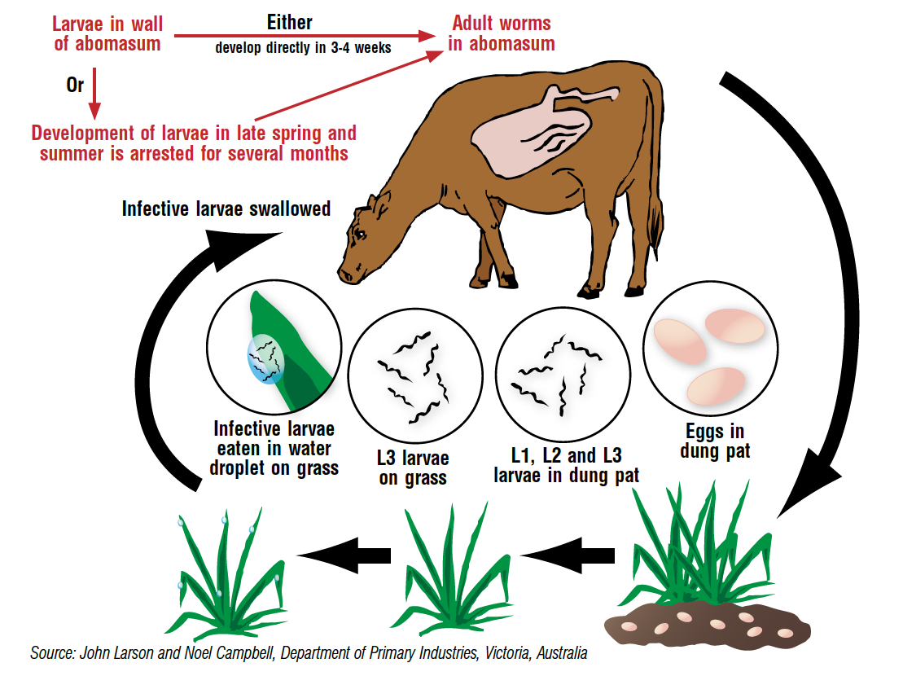

Slide 7
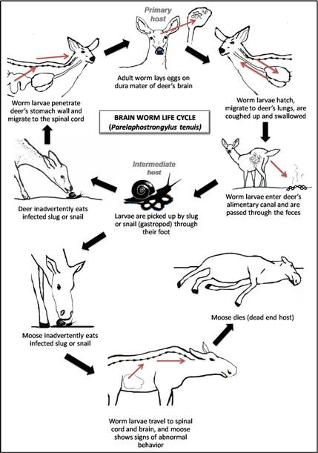
Life cycle for Parelaphostrongylus tenuis (meningeal worm)
Prepatent period: Period between infection with a parasite and presence of infective forms in blood or feces.
Intensity (=burden): Number of parasites per host
http://www.dec.ny.gov/animals/72211.html

Slide 8
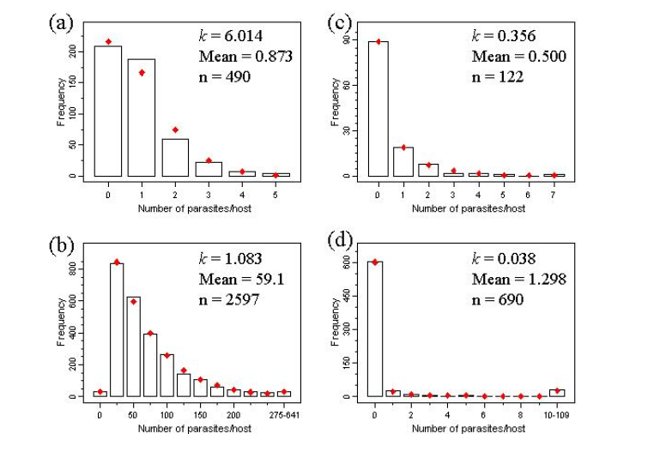
The distribution of number of parasites/host is overdispersed (variance/mean > 1) (Due to differences in exposure and susceptibility)
Wilson et al., 2001

Slide 9
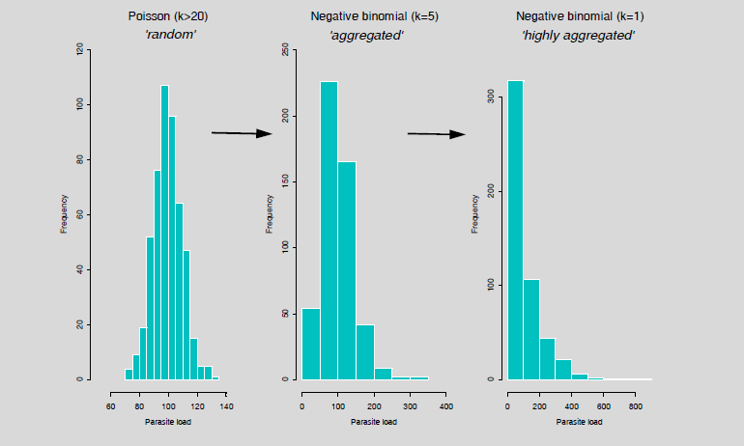
Negative binomial distribution: Distribution of the number of trials needed to get the n^{th} success

Slide 10
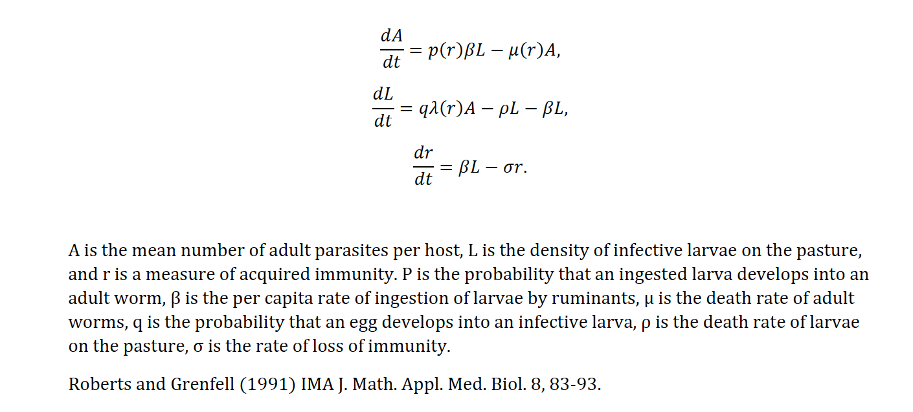
Model for nematode parasites in ruminants

Slide 11
R₀ for macroparasites
Similar to “Demographic” R₀
R₀ is the expected number of adult parasites that reach reproductive maturity produce by one adult parasite during its lifetime in the absence of density-dependent constraints on the parasite establishment, survival or reproduction.

Slide 12

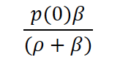
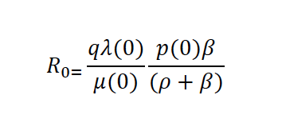
R₀ for macroparasites
Choose a reference point in the life cycle (usually ‘being newborn’ or ‘becoming adult’) and calculate for one individual at the reference point, the expected number of offspring reaching the reference point (without density-dependent feedback effects)
Free living larvae produced during the lifespan of one adult
Probability of making into an adult during the lifespan of the free living larvae

Slide 13
Model for macroparasites (host-parasite feedbacks)
Macroparasite with a direct life cycle
Births
Deaths
H
H(t): Definitive host population
Deaths
P
P(t): Parasite (Adults) population
Transmission
Production of infected stages
W
W(t): Free living infective stage population

Slide 14
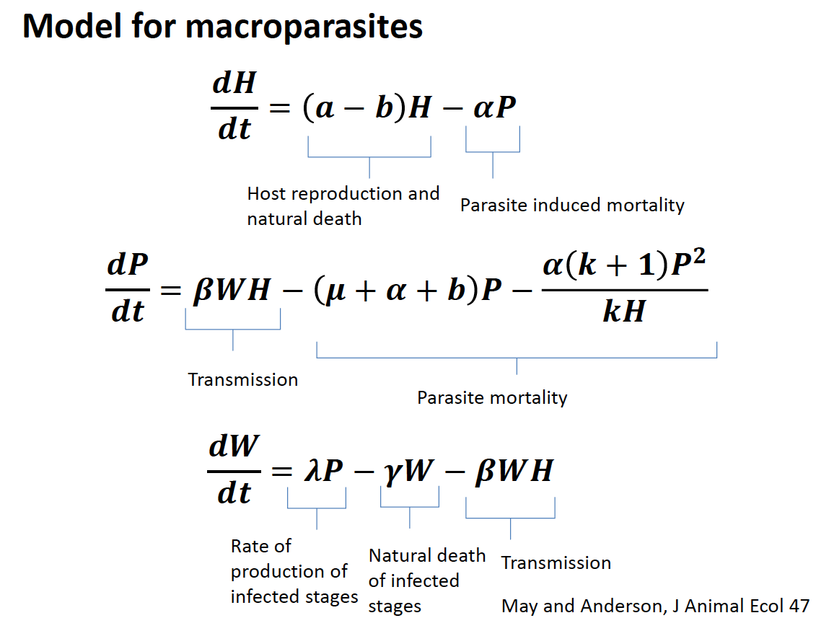

Slide 15
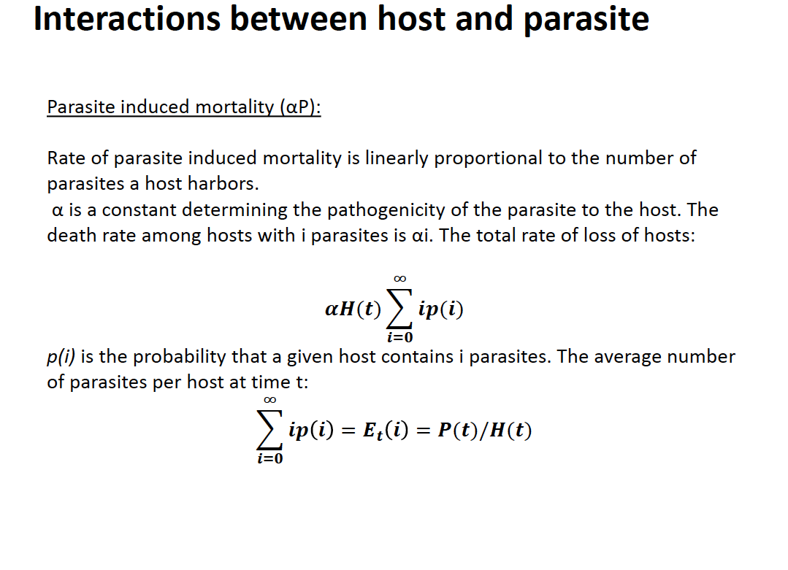

Slide 16
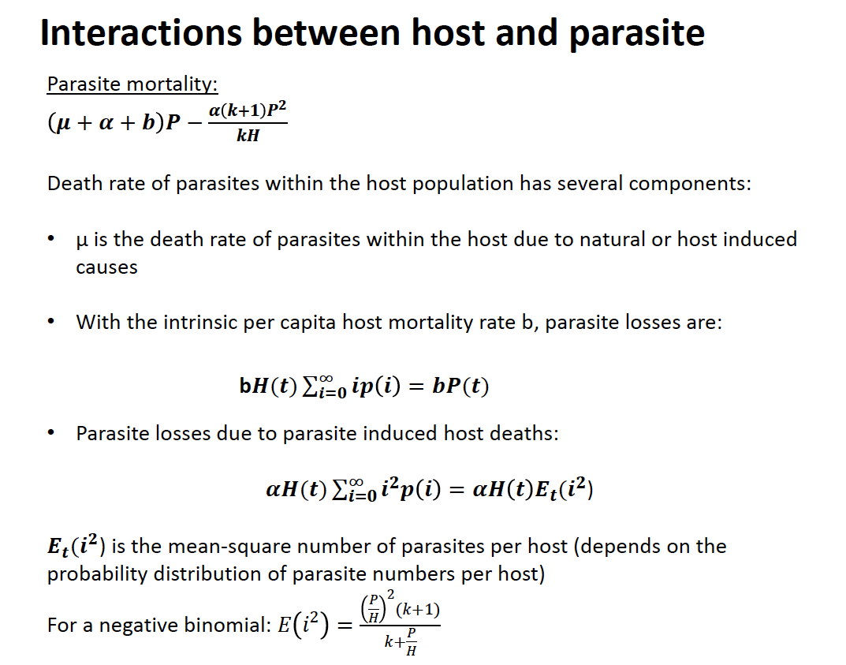

Slide 17
Some useful references
Hudson PJ, Grenfell BT, Rizzoli A, Heesterbeek H, Dobson A (2002) The Ecology of Wildlife Diseases. New York, NY: Oxford University Press.
Anderson RM, May RM (1978) Regulation and Stability of Host-Parasite Population Interactions: I. Regulatory Processes. Journal of Animal Ecology 47: 219-247.
May RM, Anderson RM (1978) Regulation and Stability of Host-Parasite Population Interactions: II. Destabilizing Processes. Journal of Animal Ecology 47: 249-267.
Heesterbeek JA, Roberts MG (1995) Threshold quantities for helminth infections. J Math Biol 33: 415-434.

